Slide 1

JA COMPANY PROGRAM
PHASE 1: INSPIRE
WEEK 2

Slide 2

WEEK 2 AGENDA
PHASE 1: INSPIRE
ATTENDANCE & ICE BREAKER (20 MIN)
DEFINING GROUP NORMS (30 MIN)
STUDENT INNOVATION (15 MIN)
CORPORATE SOCIAL RESPONSIBILITY (30 MIN)
LEADERSHIP STYLE & ROLES (45 MIN)
BRAINSTORMING (TIME AS NEEDED)
PROTOTYPING (10 MIN)
SMART GOALS (15 MIN)
ENTREPRENUERIAL RESILIENCY MODULES (10 MIN)
QUESTIONS & WRAP UP (10 MIN)
Notes:
See the appendix at the end of the presentation to find optional activities.

Slide 3


WELCOME TO WEEK 2
Notes:
Welcome & Attendance (5 min)
Take attendance based on the process shared by your local Charter.
Collect any forms that were outstanding from the first meeting.

Slide 4
DEFINING GROUP NORMS

Slide 5

What is Norming?
A norm is an informal guideline about what is considered normal social behavior in a particular group.
5 STAGES OF GROUP DEVELOPMENT
Forming
Storming
Norming
Performing
Adjourning
Notes:
Defining Group Norms (30 min)
Define what a norm is and use an example from your work environment to illustrate the concept of how norms work.
Example: In my workplace, people stop for lunch any time between about 11 and 2. But, if we were working in another place, we would be very surprised to discover that everyone stops precisely on the dot of 12 noon for lunch, whether they are ready to eat lunch or not.
Explain to the members of the company, whether you are a member of a sports team, group preparing a classroom project, or an employee on a team in the workplace, every team goes through the same 5 stages.
Forming, storming, norming, performing and adjourning are the nature of any team journey.

Slide 6




Whose Norms are These?
MATCH THESE BRANDS WITH THEIR STATED NORMS
Notes:
Defining Group Norms (30 min)
Since operating a company requires a lot of teamwork, it is important to establish team norms. Review the next slides to provide sample norms from large companies. These may serve as examples as they create their own team norms.

Slide 7




Whose Norms are These?
THINK OUTSIDE THE BOX
Lead by example
Learn from experience
Think outside the box.
Help better the brand from the inside out.
The time you spend in the office is up to you, depending on your role, needs and results. That means you can unleash your potential at work knowing your personal life is in great shape too.
Notes:
Defining Group Norms (30 min)
Review the norms and invite students to guess which company they belong to.
Answer: Coca-Cola

Slide 8
Whose Norms are These?
PRODUCTIVITY IS KEY
Get stuff done: All engineers should have written code that goes live within a week of starting work.
Use whatever tools you like best, you’ll be more productive.
There are no stupid questions. Ask anything you don’t know.
Notes:
Defining Group Norms (30 min)
Review the norms and invite students to guess which company they belong to.
Answer: Facebook

Slide 9
Whose Norms are These?
FASTER IS BETTER
It’s best to do one thing really, really well.
Fast is better than slow.
There’s always more information out there.
You can be serious without a suit.
Great just isn’t good enough.
Notes:
Defining Group Norms (30 min)
Review the norms and invite students to guess which company they belong to.
Answer: Google

Slide 10
Whose Norms are These?
BOUNDLESS POTENTIAL
We believe in the boundless potential of young people and are committed to the princes of market-based economics and entrepreneurship.
We possess a passion for what we do.
We believe in the power of partnership and collaboration.
We aim to produce an educational and motivational impact with relevant, hands-on learning experiences.
Notes:
Defining Group Norms (30 min)
Review the norms and invite students to guess which company they belong to.
Answer: Junior Achievement

Slide 11

Whose Norms are These?
How do norms affect the way a company works or behaves?
What norms should your team have?
Notes:
Defining Group Norms (30 min)
Use the prompts on the slide to generate a discussion about norms.

Slide 12






Building Your Team Norms
THINK ABOUT THE FOLLOWING CATEGORIES
Time
Confidentiality
Decisions
Expectations
Listening
Participation
Notes:
Defining Group Norms (30 min)
Encourage a discussion about each of the categories using the prompting questions below.
Review the Code of Ethics and Building Your Team Norms for a checklist of sample norms to consider
Have each team member think about what behaviours they believe will be necessary for their team to be successful and propose one team norm that they feel strongly about.
Combine similar ideas and narrow the list down to 10–15 norms that everyone agrees to.
Record these team norms.
If possible, post the team norms for reference throughout the remainder of the Company Program.
From now on, any team member can remind others of what has collectively been agreed to. The team can revisit the norms at any time and change or add to the list to help the team function more effectively.
Time
When and how often will we meet?
When will the meetings start?
When will they end?
What do we do when we will go overtime?
Expectations
How will we communicate expectations?
How will we ensure integrity?
What do we expect from the team?
What do we expect from individuals?
Confidentiality
How will we be transparent?
How will we respect privacy?
What things should be said in a meeting?
What things should not be?
Listening
How will we encourage listening?
How will we handle people who interrupt?
Decisions
How will we make decisions?
When will we use consensus?
How will we handle disagreements and conflict?
Test of Disclosure—Would all stakeholders in the company find decisions to be ethically sound?
Participation
How will we encourage participation?
Will we have an attendance policy?
How will we ensure all feel valued and included?

Slide 13

Code of Ethics
The importance of ethics in business should be woven into all aspects of the Company.
Business ethics are a set of rules or guidelines that management or individuals follow when making decisions facing their company.
Notes:
Defining Group Norms (30 min)
Define business ethics
The company needs to formulate a Code of Ethics.
Remind students about the JA Company Code of Ethics from Week 1

Slide 14



Decision-making
Unanimous: Everyone is in complete agreement.
Consensus: May not be the first preference of individuals in a group but it is a decision to which everyone can give their consent. Good consensus process relies heavily on problem-solving, questioning, empathy, and self-sacrifice.
Stalemate: An even draw in terms of those in favour and those opposed. Further discussion is required to move forward.
Notes:
Defining Group Norms (30 min)
Highlight that company norms and a code of ethics can help with decision-making
This is a good opportunity to introduce the terms unanimous, consensus and stalemate.
Explain that once the leadership team has been selected, each member of the company will be asked to sign a Code of Ethics.

Slide 15
STUDENT INNOVATION

Slide 16



Student Innovation
INNOVATION vs. INVENTION
What is the difference?
The Difference Between Invention & Innovation in Business
Notes:
Student Innovation (15 min)
In this activity, you will help students clarify the difference between innovation and invention.
Discuss the two words asking the students to offer examples of what they would consider innovation versus invention.
Look up the definitions if necessary.
A series of photographs have been collected to showcase previous products and JA student companies. Show the Product Inspiration slides that follow to the group discussing the strengths and weaknesses of each one based on first impressions and limited information. How would the group classify each example – innovation or invention?
Consider the following discussion questions:
a. Why are these innovations?
b. What problems were the Achievers trying to solve?
c. Do you think these products fill a need in the market?
d. Are these filling a customer “want” or a “need”?
e. What are some things that customers want?
f. And what do they need?
g. How would you know the difference?

Slide 17

Product Inspiration
INFINITEA TEA-SHIRTS
JA CENTRAL ONTARIO
INFO ABOUT THE COMPANY
Created origami shirs and put tea bags inside of them creating TEA-SHIRTS.
Sold in sets of seven (one for every day of the week).
WHAT SET THEM APART?
Creative
Resourceful
Combined food and fashion
Unique gift idea
THINGS TO THINK ABOUT
Production process
Quality Assurance
Packaging
Competition
Notes:
Student Innovation (15 min)
Discuss the strengths and weaknesses based on first impressions and limited information. How would the group classify this example – innovation or invention?
Consider the following discussion questions:
a. Why are these innovations?
b. What problems were the Achievers trying to solve?
c. Do you think these products fill a need in the market?
d. Are these filling a customer “want” or a “need”?
e. What are some things that customers want?
f. And what do they need?
g. How would you know the difference?

Slide 18

Product Inspiration
SITTO BABYSITTING APP
JA CENTRAL ONTARIO
INFO ABOUT THE COMPANY
Think of them like the “Uber” of babysitting.
Customers can find babysitters, and book and pay using their app.
WHAT SET THEM APART?
Innovative
Convenient
Fills a need
Defined target market
On trend
THINGS TO THINK ABOUT
Tech requirements
Cost of app development
Risk and liability coverage
Time required from ideation to full launch
Notes:
Student Innovation (15 min)
Discuss the strengths and weaknesses based on first impressions and limited information. How would the group classify this example – innovation or invention?
Consider the following discussion questions:
a. Why are these innovations?
b. What problems were the Achievers trying to solve?
c. Do you think these products fill a need in the market?
d. Are these filling a customer “want” or a “need”?
e. What are some things that customers want?
f. And what do they need?
g. How would you know the difference?

Slide 19
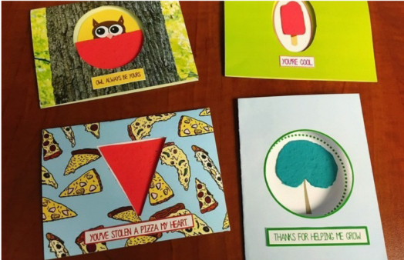
Product Inspiration
CARDS REINCARNATE
JA BRITISH COLUMBIA
INFO ABOUT THE COMPANY
Sold creative greeting cards that contained wildflower seeds.
Lots of unique design options and managed to get unique sales venues
WHAT SET THEM APART?
Quality of product
Impressive branding
Creative themes
Enviro-friendly
Digital marketing
THINGS TO THINK ABOUT
Production costs
Supply and demand
Competition
Consistency with quality and designs (due to being handmade)
Notes:
Student Innovation (15 min)
Discuss the strengths and weaknesses based on first impressions and limited information. How would the group classify this example – innovation or invention?
Consider the following discussion questions:
a. Why are these innovations?
b. What problems were the Achievers trying to solve?
c. Do you think these products fill a need in the market?
d. Are these filling a customer “want” or a “need”?
e. What are some things that customers want?
f. And what do they need?
g. How would you know the difference?

Slide 20
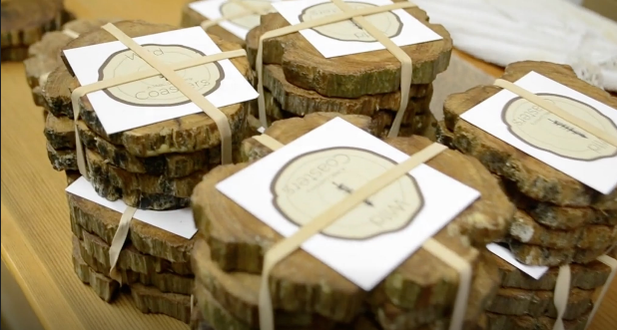
Product Inspiration
WILD COASTERS
JA BRITISH COLUMBIA
INFO ABOUT THE COMPANY
Wooden coasters made from abandoned tress collected locally
Raise awareness about deforestation and support the local community
WHAT SET THEM APART?
Enviro-friendly
Supporting the community through donating a portion of sales
THINGS TO THINK ABOUT
Production
Quality Assurance
Packaging
Notes:
Student Innovation (15 min)
Discuss the strengths and weaknesses based on first impressions and limited information. How would the group classify this example – innovation or invention?
Consider the following discussion questions:
a. Why are these innovations?
b. What problems were the Achievers trying to solve?
c. Do you think these products fill a need in the market?
d. Are these filling a customer “want” or a “need”?
e. What are some things that customers want?
f. And what do they need?
g. How would you know the difference?

Slide 21
CORPORATE SOCIAL RESPONSIBILITY

Slide 22
Corporate Social Responsibility
ENVIRONMENTAL
Corporate Social Responsibility is a voluntary approach that businesses take to meet or exceed shareholder expectations.
Doing well by doing good
SOCIAL
ETHICAL
NEW SCHOOL
OLD SCHOOL
PROFIT
LEGAL
REVENUE
Notes:
Corporate Social Responsibility (30 min)
Corporate Social Responsibility (CSR) is a voluntary approach that business takes to meet or exceed shareholder expectations. It considers economic, social, environmental, and smart growth and mobility implications in the decision-making process. It is a departure from making business decisions based solely on the financial bottom-line.

Slide 23

What are the Trends?
MODERN CORPORATIONS HAVE DEVELOPED NEW TRENDS
To deliver the good, not just the goods
To pursue values, not just value
To help make the world a better place
WHAT DOES THIS MEAN?
‘Good deeds’ are built into business plans
Corporations give back to the community, not just shareholders
Notes:
Corporate Social Responsibility (30 min)

Slide 24




Triple Bottom Line
Companies are setting standards where the bottom line is about more than just money.
FINANCIAL PERFORMACE
Be profitable – legally
ENVIRONMENTAL SUSTAINABILITY
Reduce, reuse, recycle
SOCIAL RESPONSIBILITY
Community participant
Notes:
Corporate Social Responsibility (30 min)

Slide 25




Why Bother?
CSR can help your company!
Customers like it – sales and loyalty increase
Employees like it – more engaged
CSR helps:
The environment
The community
Saves money
Notes:
Corporate Social Responsibility (30 min)
Even though it is early in the process, it is important for students to begin to think about if their company with have a CSR component. Ask the students:
a. How can your JA Company engage in CSR?
b. How are the three P’s going to impact your business? (profit – financial performance, planet – environmental sustainability, people – social responsibility).
c. How is the Code of Ethics going to impact your business?
Review the examples on the next slides to learn about how other companies implement CSR.

Slide 26


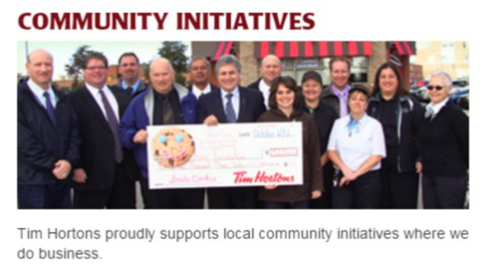
Example 1
TIM HORTONS
Involved in fair trade
Sponsors sports and other community initiatives
Notes:
Corporate Social Responsibility (30 min)
Tim Horton’s coffee partnership helps build sustainable coffee communities by supporting farmers in key areas that will improve their coffee business and their lives.
Tim Horton’s proudly supports local community initiatives in the communities they do business.

Slide 27


Example 2
TOMS SHOES
One for one
With every product purchased, the customer is helping one person in need.
Notes:
Corporate Social Responsibility (30 min)

Slide 28



Example 3
TENTREE
Partnered with non-profits to provide a long-term solution to restoring the ecosystem and offering long-term employment to local communities.
Notes:
Corporate Social Responsibility (30 min)

Slide 29
LEADERSHIP STYLE & ROLES

Slide 30


Styles of Leadership
What makes a good leader?
What is your leadership style?
Notes:
Leadership style & roles (45 min)
Explain that everyone will have a role within the company and be an important member of the team. Some students may choose to nominate themselves for a management role and choose to take on a leadership role.
Optional - Present one or two of the suggested videos on the following slides to start a discussion on the different styles of leadership
Optional – If students completed the “What’s your leadership style?” quiz, discuss their results.

Slide 31
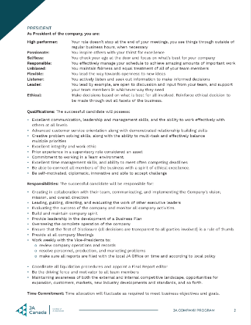
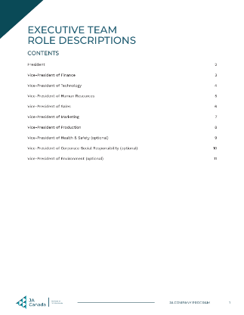
Executive Team Roles
ESSENTIAL ROLES
President
VP Finance
VP Marketing
VP Sales
VP HR
VP Production
VP Technology
OPTIONAL ROLES
VP Corporate Social Responsibility + ethics
Notes:
Leadership style & roles (45 min)
Review the core roles and responsibilities within the company
Refer to the Executive Team Role Descriptions PDF for key qualities, qualifications and responsibilities for each role.
It is up to the team to choose how many roles are actually needed for their company (dependent on size, interest, etc.). The organizational charts are examples only – roles can be shared or combined.
Note: Check with your local Charter about JA Awards as some of the Management roles may be associated with awards.
Review the Company Program Executive Team Selection Options PDF to determine how executives will be selected.
Optional - Professional Social Media Profile (15 min)
As students are preparing their nomination speeches, encourage them to reference the Professional Social Media Profile Checklist PDF.
See slides at the end of the presentation in the Appendix.

Slide 32
BRAINSTORMING

Slide 33
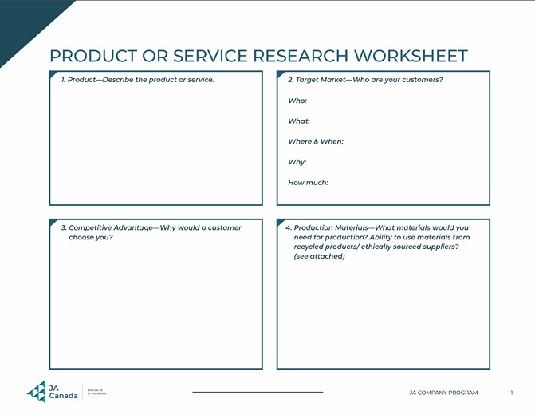

Product or Service Research Assignment
Continue working on the Product or Service Research Assignment.
Notes:
Brainstorming (as required and as time permits)
Allot time for students to continue working on the Product or Service Research Assignment.
If students are still not sure about their idea you can help students clarify the difference between innovation and invention by revisiting the Student Innovation slides (Slide 24 – 29). Discuss the two words asking the students to offer examples of what they would consider innovation versus invention. The Innovation or Invention video can be used to spark the conversation. Look up the definitions if necessary.
Revisit the Product Inspiration slides with the group discussing the strengths and weaknesses of each one based on first impressions and limited information. How would the group classify each example – innovation or invention? Consider the following discussion questions: a. Why are these innovations? b. What problems were the Achievers trying to solve? c. Do you think these products fill a need in the market? d. Are these filling a customer "want" or a "need"? e. What are some things that customers want? f. What do these customers need? g. How would you know the difference?
Optional - Human-Centered Design
Human-Centered Design Thinking is an innovative way of approaching a problem when searching for product inspiration. Show the Human-Centered Design Thinking slides to encourage this approach to problem-solving.
See slides at the end of the presentation in the Appendix.
Spend time with groups or individuals discussing their ideas to get a sense of what might be presented during pitches.

Slide 34
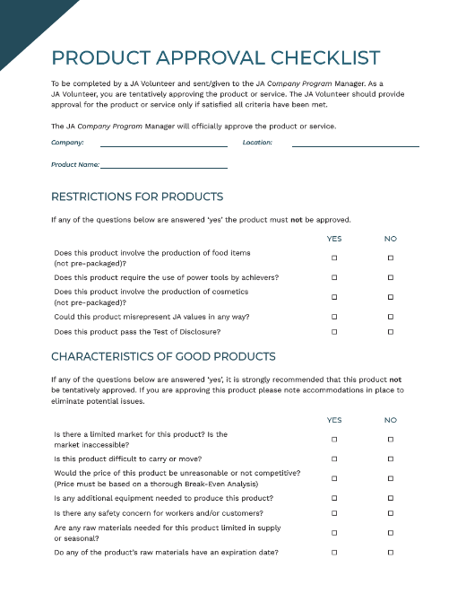
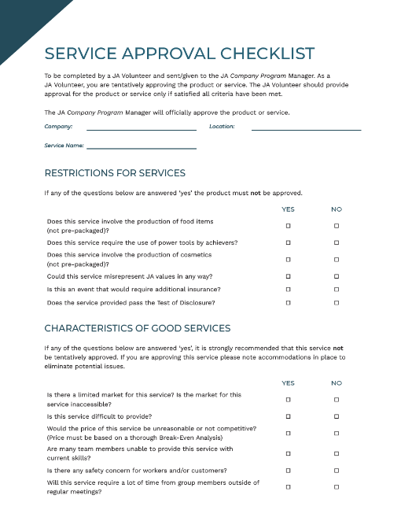

Product & Service Checklist
Check that your product or service meets the guidelines to qualify for the program.
Notes:
Brainstorming (as required and as time permits)
Remind students about the Product and Service guidelines and review the Product and Service Checklist PDFs to ensure that their products qualify for the program.
Students will fill these out in Phase 3 but can be used as reference as they ideate.

Slide 35
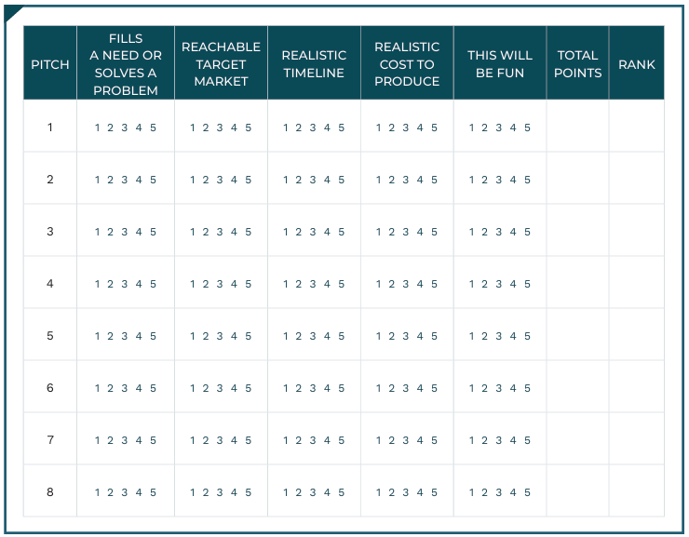

Pitch Evaluation Criteria
How will your pitch be evaluated?
Notes:
Brainstorming (as required and as time permits)
Discuss the selection process for ideas with students and review the Pitch Evaluation Criteria the group will use.
Be sure to answer all questions students have and highlight that this is a very important decision for the company to be successful.

Slide 36
IMPORTANCE OF PROTOTYPING

Slide 37

What is a Prototype
A prototype is an initial or preliminary version from which your product is developed to provide insight into the functionality of your design and inform changes needed.
Notes:
Importance of Prototyping (10 min)
As students are working through ideas, review with them the importance of preparing a prototype.
A prototype is defined as: an initial or preliminary version from which your product is developed to provide insight into the functionality of your design and inform changes needed
The biggest benefit of prototyping is that it prevents important factors from being overlooked and it stops you making any assumptions that could be revealed as inaccurate later on in the process.

Slide 38

Prototyping is Important
1. EVALUATE AND TEST YOUR IDEA
Notes:
Importance of Prototyping (10 min)
Prototyping is important for several reasons:
1. Evaluate and Test Your Idea
Ideas and drawings of a design can sometimes be a far cry from the real world in which the product will be used.
By creating a prototype, it is possible to sit down with a preliminary version of the product vision and determine what works and what does not.
Often glaring omissions emerge that, initially, weren’t obvious.

Slide 39
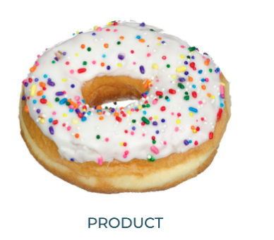
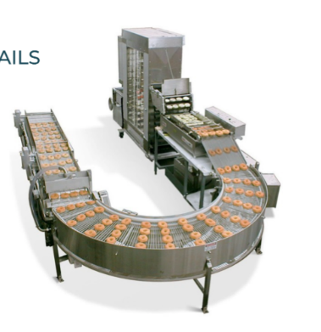
Prototyping is Important
2. CLARIFY PRODUCTION DETAILS
Notes:
Importance of Prototyping (10 min)
Prototyping is important for several reasons:
2. Clarifying Production Details
By prototyping before production begins, it is possible to take a glimpse at the production process and see if any steps can be changed, combined or even removed.
This streamlines production and minimizes production costs.
An idea without a prototype is just a theoretical concept.
Prototypes often greatly enhance product pitches.

Slide 40
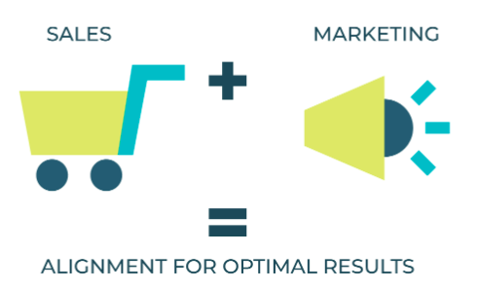
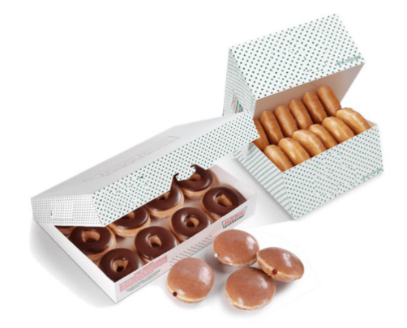
Prototyping is Important
3. SELLING YOUR IDEAS
Notes:
Importance of Prototyping (10 min)
Prototyping is important for several reasons:
3. Selling Your Ideas
It is also far easier to sell to potential customers when they can hold a prototype during your pitch.
It can be difficult to get commitment with only a vague concept.
Students can create prototypes using materials around their house/school or purchase low-cost materials or using online technology if available.

Slide 41
SMART GOALS

Slide 42
SMART Goals
Write a SMART goal related to what you want to get out of Company Program.
S | M | A | R | T
Specific | Measurable | Attainable | Relevant | Timely
What exactly are you going to achieve? How detailed can you get? | What tangible evidence will show accomplishment? How will you know you succeeded? | Is the effort and commitment needed realistic? Can you envision the results? | Why is your goal really important to you? How will you persevere when it gets hard? | When will you cross the finish line? What pace will you set? How will you prioritize the things that matter most to you?
Notes:
SMART Goals (15 min)
View the SMART Goals video
Explain that as a Company students will eventually create goals together.
For now, ask them to apply the concept they have learned and write down a SMART goal related to what they want to get out of this program.
Have each student write their SMART goal on a piece of paper, then fold it in half and put their name on it. Mentors will collect the goals and hand them back at the end of the program.

Slide 43
ENTREPRENEURIAL RESILIENCY MODULES

Slide 44
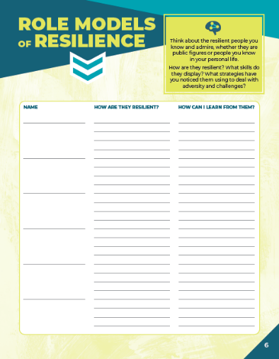
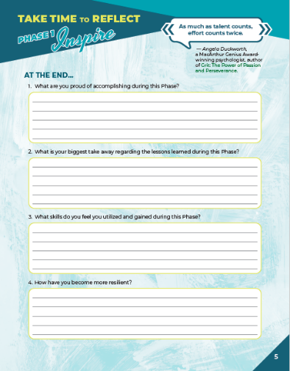

Company Program Resiliency Modules
Entrepreneurial resiliency is the ability to adapt to changes in your business and bounce back when things are challenging.
As you complete the JA Company Program, use this journal to reflect on your own resiliency and the skills you are gaining.
Notes:
Company Program Resiliency Modules (10 min)
Using the Company Program Resiliency Modules advisor guide, follow the instructions to guide students through the remaining activities and discussions for Phase 1.

Slide 45
QUESTIONS & WRAP UP

Slide 46



Questions & Next Steps
QUESTIONS?
NEXT STEPS
Complete/return all forms
Complete the Product or Service Research Assignment for one idea
Prepare to pitch to the group
Notes:
Wrap-Up (5 min)
Create an opening for students to ask any questions about the meeting prior to wrapping up.
Students will not have time to practice or finish pitches at the next meeting, therefore they must prepare in advance.
Review the next steps with students:
Remind students to bring all forms, to the next meeting if they did not have them with them already.
Instruct students to complete the Product and Service Research for one idea and prepare to pitch to the group.
Advisors:
Gather attendance records & any outstanding forms
Take a few moments to debrief about the first session with the team of Advisors
If you were not able to cover any material, make a note and move it to your next meeting
Address any questions, concerns or feedback to your Program Manager
Congratulations on completing your second meeting!
Transition to Phase 2: Unite
Depending on the dynamics of the group and the schedule of local events organized by your Charter, some flexibility may be necessary for Phase 2: Unite. Check with your Charter regarding their recommendations.
Phase 2, Unite (Week 3): Students will either continue to brainstorm or pitch their ideas, vote on their product/service then form their Companies
Phase 2, Unite (Week 4): Students will either pitch their ideas and vote their product / service (if not completed in Week 3) and / or elect their Management team.
In some cases, it may be beneficial to elect a Management team before choosing the product or service. Regardless of the path you take, by Week 5 all JA Companies should be starting Phase 3: Build.

Slide 47
APPENDIX
OPTIONAL ACTIVITIES
WEEK 2

Slide 48
PROFESSIONAL SOCIAL MEDIA PROFILE

Slide 49
LinkedIn Guidelines JA Canada Guidelines for CP Student Profiles
Category | Approved and Recommended | Not approved
Background | Template or personal background | Custom background using JA trademark
Experience Summary | Must include JA Student Company before CP company and role i.e. JA Student Company, ABC, VP, Finance | Reference to JA as an employer
Experience Type | Internship | Other options including contract, seasonal, co-op
Logo | JA Company logo if there is a LinkedIn page for company (otherwise name only) | JA Canada, JAWW or charter logo
Education | Add JA Canada as an organization Reference to JA Company Program | Reference to a JA as an educational institution Reference to obtaining a degree or diploma through JA
Skills | Add skills learned through JA Company Program i.e. team building, leadership
Interests | Include JA as an organization to follow
Connections | When reaching out to people in the JA network communicate that you are a JA student | Referring to yourself as an employee of a JA organization
Notes:
Professional Social Media Profile (15 min)
Many students will gain their first real-world experiences through JA Company Program.
To support them in their journey to building successful careers and a part of the development of their professional skills, review the table to provide guidance around creating profiles that accurately represent their experience and affiliation with JA.
Review the guidelines for students to follow when referencing their JA experience in an online profile.

Slide 50
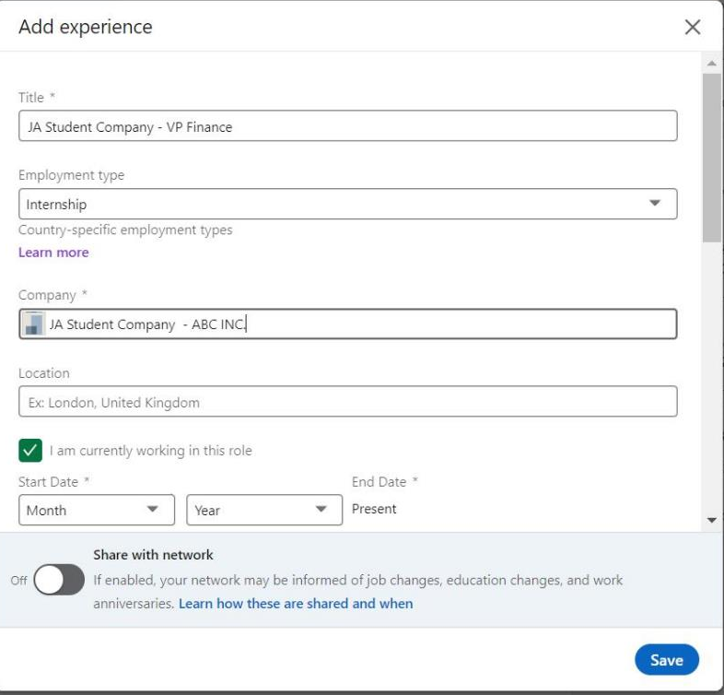
Sample Experience Profile
Include JA Student Company and your role in the title field
Use internship in the employment type field
Include JA Student Company and your company name in the company field.
Notes:
Professional Social Media Profile (15 min)
Review the example screenshot of how students can add their experience on their LinkedIn profile.
Highlight that they should include “JA Student Company” and their role in the title and their company name below.

Slide 51
HUMAN-CENTERED DESIGN

Slide 52

Human-Centered Design
Human-centered design thinking:
Grounds innovation in rich understanding of human needs
Understands problems first before investing in solutions
Creates holistic innovation concepts
Makes the future tangible to inspire action
Notes:
Human-Centered Design
Human-centered design thinking is an innovative way of approaching a problem when searching for product inspiration.

Slide 53





Human-Centered Design
5 PHASES
Frame
Discover
Analyze
Create
Develop
Notes:
Human-Centered Design
Review the 5 phases of human-centered design

Slide 54
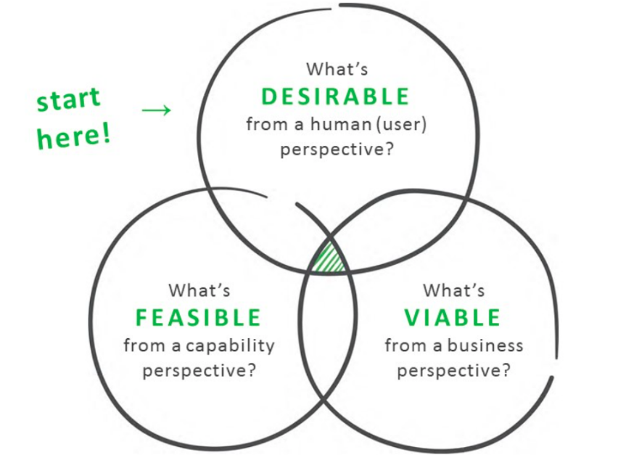
Frame
BUSINESS PROBLEMS VS. HUMAN PROBLEMS
Balanced breakthrough model
Are you doing what you do because you can or because you should?
Notes:
Human-Centered Design
Review the elements of the balanced breakthrough model
What’s desirable from a human (user) perspective?
What’s feasible from a capability perspective?
What’s viable from a business perspective?

Slide 55



Frame
If I had an hour to solve a problem, I’d spend 55 minutes thinking about the problem and 5 minutes thinking about solutions.
- Albert Einstein
Notes:
Human-Centered Design
Ask: Why do you think Albert Einstein said this?

Slide 56

Activity
Design a better bed.
INSTRUCTIONS
You decide what this statement means
Draw or write about your design
This is a quiet activity
2, 4, All Share-out
Notes:
Human-Centered Design
Follow the instructions on the slide to begin the activity
Once students have completed their independent drawing or writing, begin sharing as follows:
2 – Students share with a partner
4 – Partners share with another set of partners
All – Students share in a full group discussion

Slide 57

Activity
Design a better way to sleep.
INSTRUCTIONS
You decide what this statement means
Draw or write about your design
This is a quiet activity
2, 4, All Share-out
Notes:
Human-Centered Design
Follow the instructions on the slide to begin the activity
Once students have completed their independent drawing or writing, begin sharing as follows:
2 – Students share with a partner
4 – Partners share with another set of partners
All – Students share in a full group discussion

Slide 58


Activity
DISCUSS
How did the question affect your design?
Design a better bed vs. design a better way to sleep.
Notes:
Human-Centered Design
Explain that spotting the difference between a business frame and a problem frame matters.

Slide 59
Activity
WHO IS OUR USER?
Articulate precisely who you are trying to understand more deeply (i.e. demographic, behavioural, functional)
WHAT IMPACT DO WE WANT TO HAVE?
Consider what will be different about the world when you solve this problem.
WHAT ARE WE TRYING TO UNDERSTAND AND INFLUENCE?
Describe the exact human behaviours, activities or tasks that you’re interested in and what you want to change.
WHAT IS THE SCOPE?
Set some boundaries around where the solution might lie (i.e. a new feature, a new service, a new business).
Notes:
Human-Centered Design
Framing should be a discussion with your project team.
Your problem frame can be refined or iterated on.
Ultimately, you and your team should find consensus and move forward with one frame.
Invite students to use the Framing worksheet to complete the activity.

Slide 60
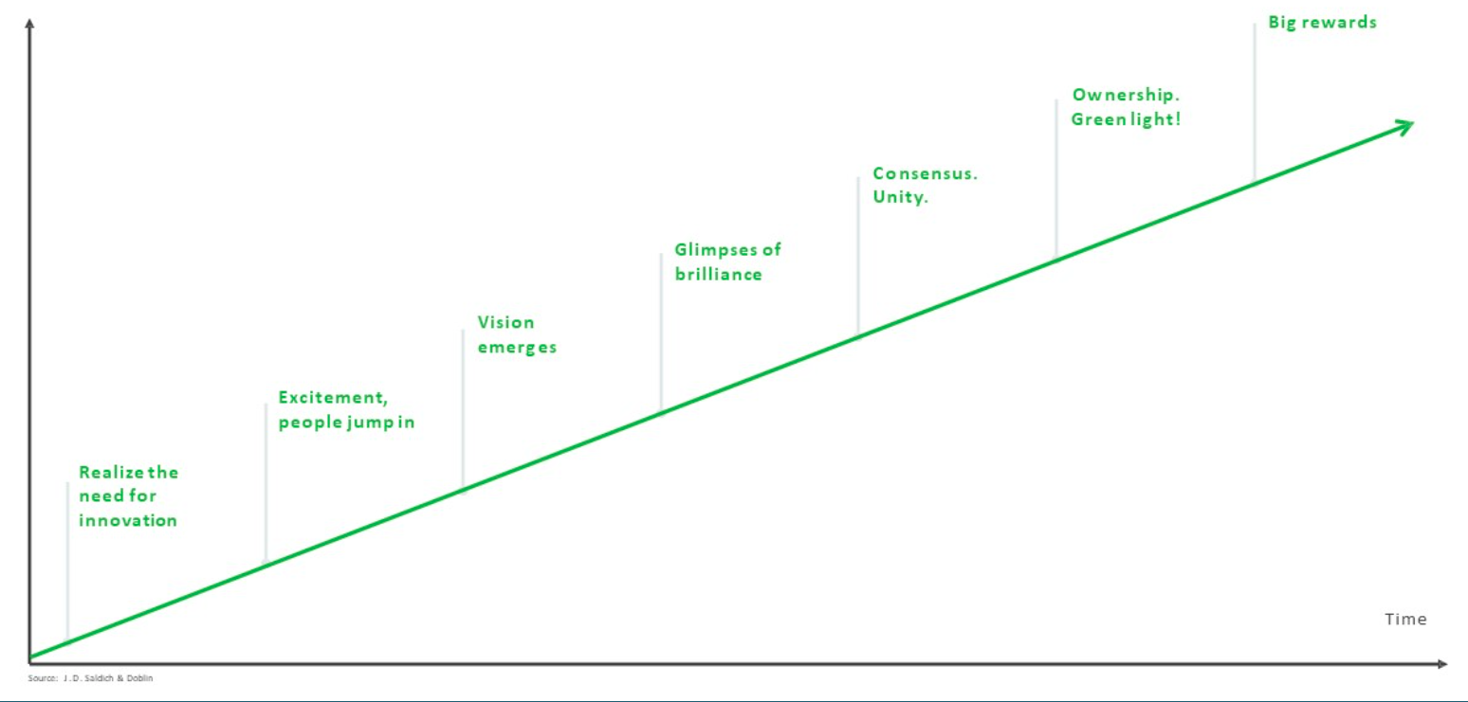
Energy, Enthusiasm, Results
Notes:
Human-Centered Design

Slide 61
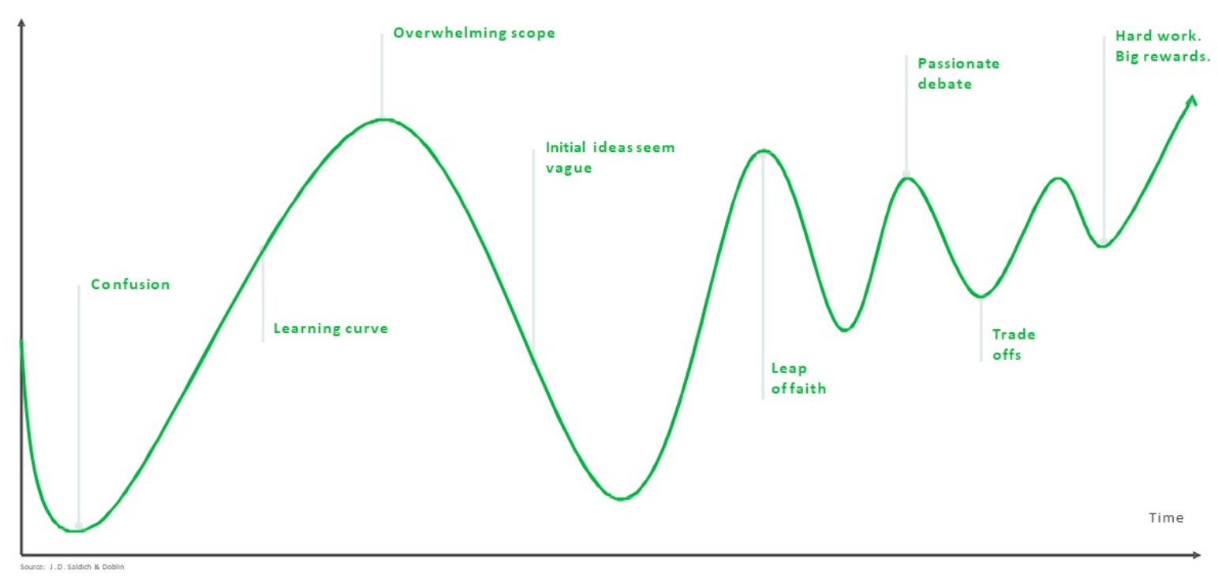
Energy, Enthusiasm, Results
Notes:
Human-Centered Design

